Slide 1
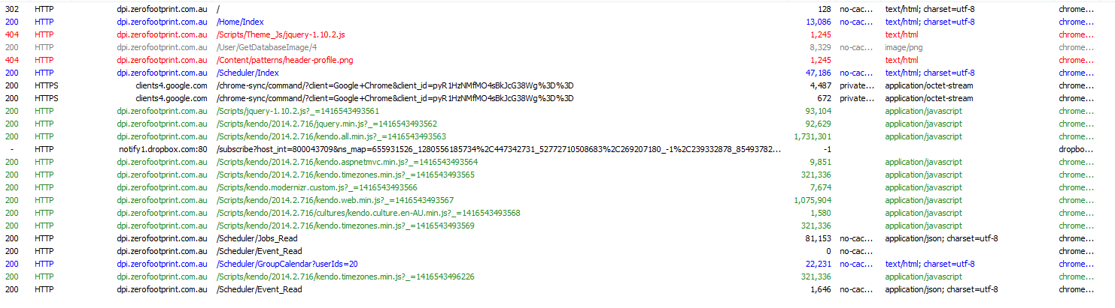
Fiddler : 1. 404 on some .js files missing. 2. There are some very large js processes. What are these doing, these are 3: When logging in you are repeatedly calling this kendo.web.min.js file which is 300K. In looking at the contents of this file, I seriously don’t know why its been repeatedly downloaded.
1
2

Slide 2
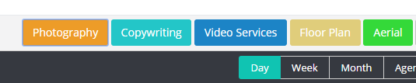
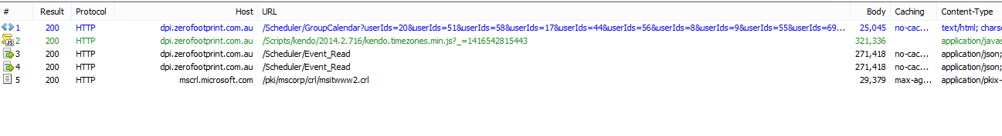
FIDDLER: When pressing a service button, i.e. photography, it calles the Read method twice, sequentially returning 271K of exact data twice? DEFECT and will have serious performance impact. This requires a CRITICAL FIX

Slide 3
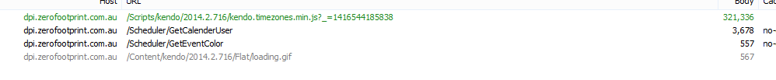
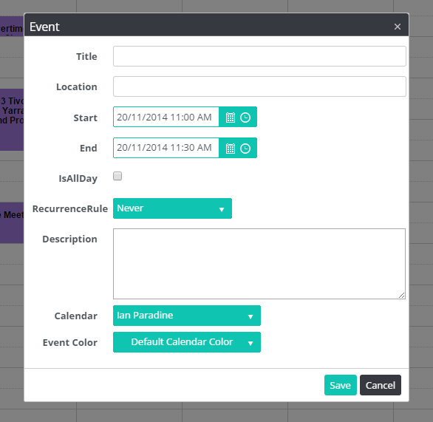
FIDDLER: Every time you edit/create an even you are calling this kendo.timezonesmin.jk. This is 321K of data transfer each time. This is seriously slowing execution time. This requires a CRITICAL FIX

